Slide 1
Data Sourcing / Cleaning

Slide 2
Data Licensing
Can you use any data?
Check data sources for restrictions (commercial uses, foreign uses, etc)
MIT License
  Very permissive, as long as you keep the license and copyright
GPLv2/v3
  If you use it, you must distribute the source of anything built with it
  Must include copyright, license, link to the original, and details of your changes
  “Spreads virally”, anything that uses it must then become GPL

Slide 3
Data Sources
Data is everywhere! We can track things at scales that we never have before
Refined Datasets
  These are typically academic or governmental datasets that are released to the public
  For the most part all the cases of missing values and parsing is done for you (the data is in a table-like format)
Raw Data
  This can be any data source:
    Social media, sensor data, scientific data
  You will need to clean the data in order to get it to a usable state
    i.e. Missing values? Formatting? Non-normalized data?

Slide 4
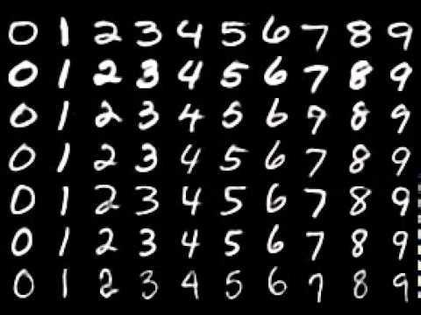
Premade Dataset
There are a lot of good data sources already
If you can, use them instead of getting your own data
  It has been cleaned; typically easier to download
  There are other papers you can look to for examples of how they manipulated it
You may want to combine datasets or fill in null values
https://github.com/cazala/mnist

Slide 5

Raw Data
How would you process your newsfeed?
http://static.adweek.com/adweek.com-prod/wp-content/uploads/sites/2/2016/02/NewsFeedTeaser640.jpg

Slide 6
Raw Data - Web Scraping
Ideally you start with a headless browser and download a subset of the javascript objects/html from the page
Once you have the objects, save them in some format that makes sense. This can be a CSV, a Table, what have you.
You may need to do some HTML parsing in this case. Get yourself an HTML parser and write all the relevant files

Slide 7
20 Second Example
from bs4 import BeautifulSoup soup = BeautifulSoup("""
<html><body><ul>
<li class="shoe-item">Air Jordans</li>
<li class="shoe-item">Light up Sketchers</li>
</ul><body></html> """, 'html.parser')
for item in soup.find_all(attrs='shoe-item'):
print(item.text)

Slide 8

Scraping Problems
You may get rate limited
You may get blocked
You may be violating the law
Whenever the HTML changes, your code immediately breaks
http://4.bp.blogspot.com/--POGMPcheZQ/U3AFerYzrKI/AAAAAAAABDo/ uNPZGsCpGAI/s1600/web+scraping+jime.jpg

Slide 9
Data Cleaning

Slide 10
Why do we need to clean the data?
Data could have:
  Missing Values
  Duplicate Values
  Invalid Values
  Useless Values
  Etc
We need to make sure that the data that we give to the machine learning algorithm is as close to representative as possible

Slide 11
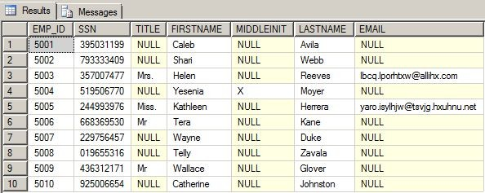
Why do we need to clean the data?
We usually want the data in some normalized format
https://www.red-gate.com/simple-talk/wp-content/uploads/imported/1519-image003.png

Slide 12
Missing Values
What can we do?
We can drop data
  Careful: this may skew our dataset, especially if we have a lot of missing values.
We can make an educated guess of the values
  Hard to do for categorical data
  For numerical data:
    Simple replacement with the mean
    Sample a probability distribution to fill in the values (randomly)
Some algorithms don’t need all the values filled in
  In that case, we leave as is because we want to put as little of our bias into the data

Slide 13
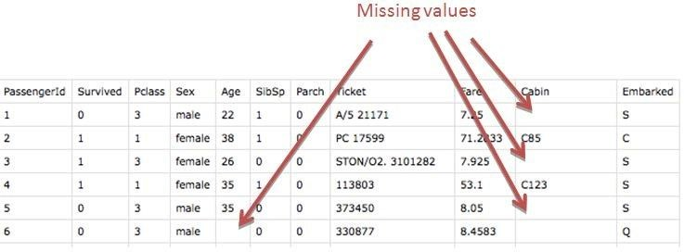
Missing Data Example

Slide 14
Duplicated Data
Simple answer:
  Deduplicate the data
  Can be challenging with very large datasets
Pitfalls:
  Duplicate data can have meaning
  How do you determine duplicate data?
    Exact match? Close match?

Slide 15
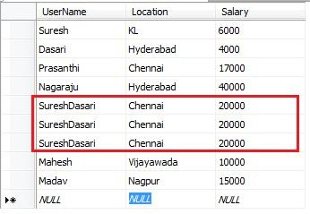
Duplicates Example

Slide 16
Invalid and Useless Values
Problem domain species what is valid / useful
Context matters significantly:
  i.e., age > 0
For “useless” values
  Keep them around, they may be useful later

Slide 17
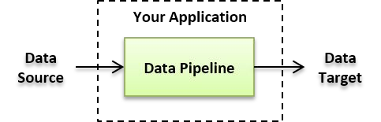
Data processing pipelines

Slide 18
Final Destination
Your data needs to be accessible to your processing framework
  i.e. It needs to be placed in HDFS, S3, MySQL, etc.
For Hadoop / Spark:
  HDFS has the “copyFromLocal” tool
For SQL Databases:
  Many tools available for loading data
  Write your own queries/scripts to load data from some other source
Data can be very large (> 1 PB):
  Services like AWS Data Transfer (Snowball) exist to bulk transfer large amounts of data

